Slide 1

Model OSI
Olga Rymarchuk

Slide 2
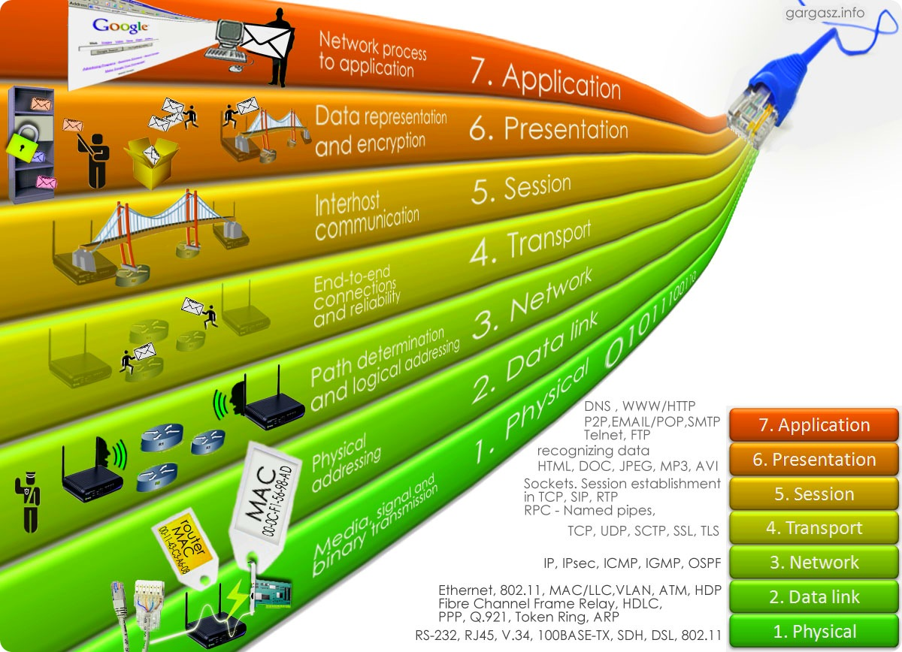
Model OSI
Concept
Levels
OSI stack
The disadvantages of the OSI model

Slide 3

Model OSI Concept
In the early 80's, a number of international standardization organizations - ISO,
ITU-T and several others have developed a model that has played a significant role in the development of networks.
This model is called the Open System Interconnection (OSI) or OSI model.

Slide 4
Model OSI Concept
The OSI model defines different levels of system interaction, gives them standard names, and specifies what functions each level should perform.
In the OSI model, the interaction tools are divided into seven levels: application, representative, session, transport, network, channel, and physical. Each layer deals with one particular aspect of network device interaction.

Slide 5
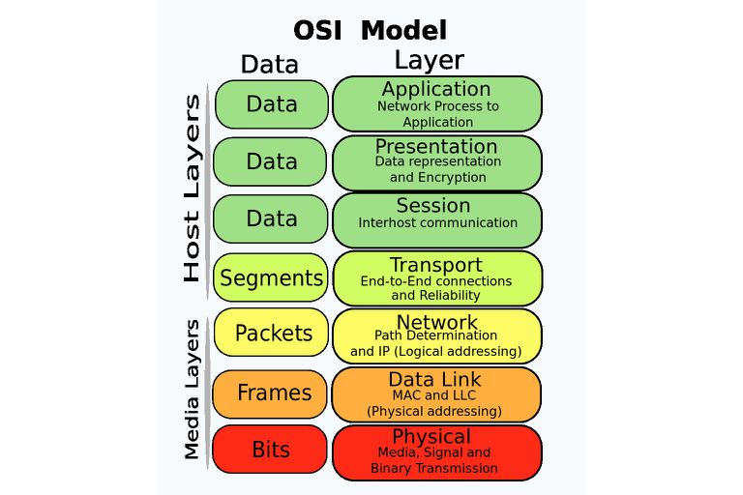
Model OSI

Slide 6
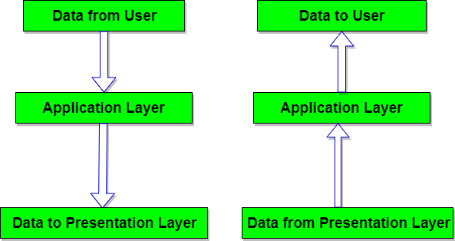
Model OSI Levels
Application level
The top (7th) layer of the OSI network model provides network and user interaction.
It is also responsible for transmitting service information, providing applications with error information, and generating requests to the view layer.

Slide 7
Model OSI Levels
Presentation
This layer is responsible for protocol conversion and data encoding / decoding.
At this level, data can be compressed / unpacked or encoded, and requests can be redirected to another network resource if they cannot be processed locally.

Slide 8
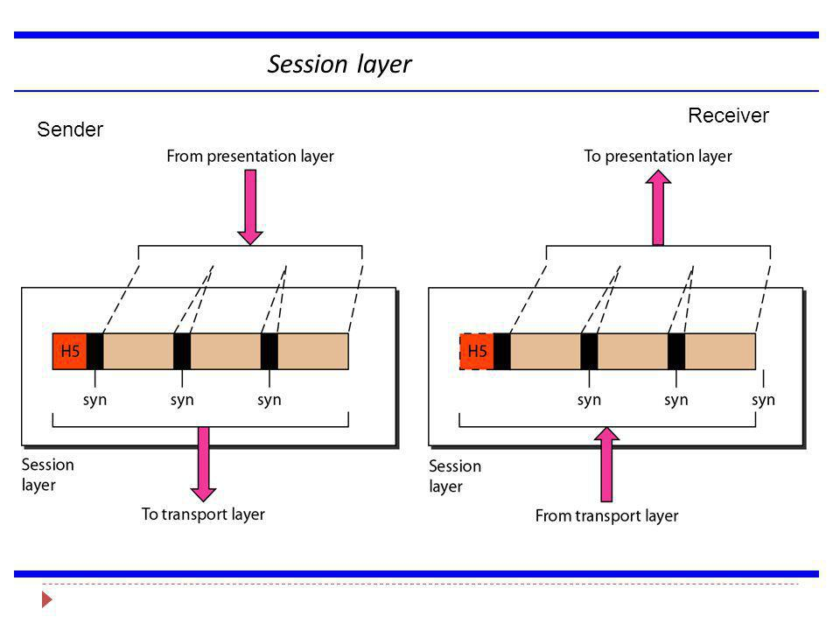
Model OSI Levels
Session level
The 5th layer of the OSI network model is responsible for maintaining the session, allowing applications to interact for a long time.

Slide 9
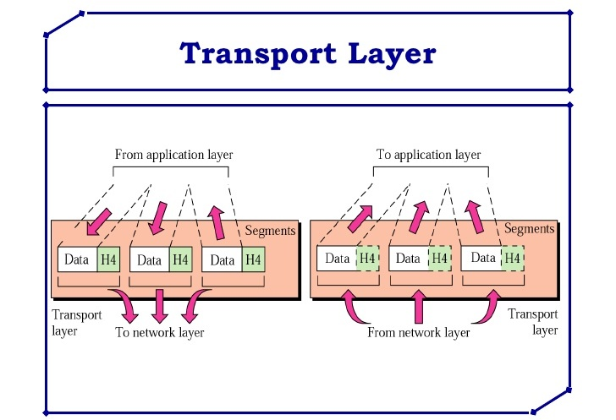
Model OSI Levels
Transport level
The fourth layer of the OSI network model is designed to deliver data without errors, losses and duplication in the order they were transmitted.

Slide 10
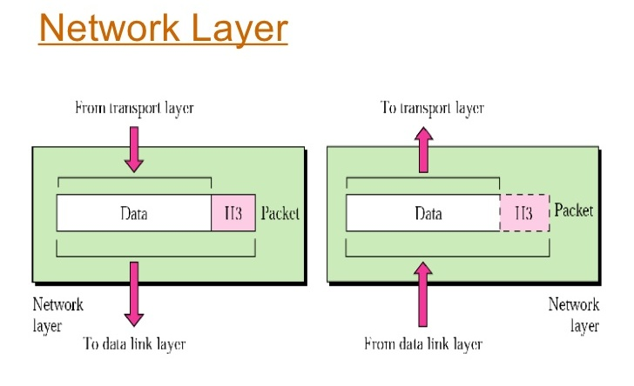
Model OSI Levels
Network layer
The third layer of the OSI network model is intended to determine the transmission path.
At this level, a network device such as a router operates.

Slide 11
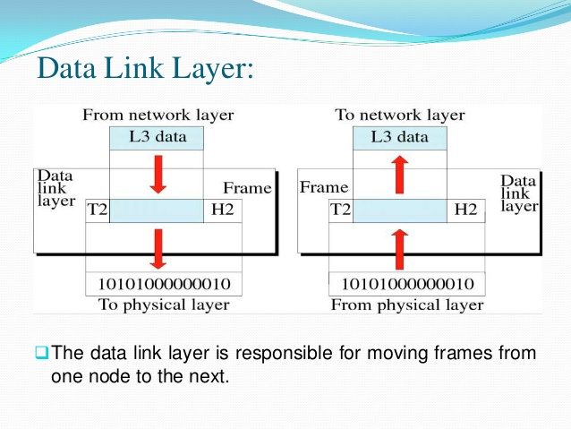
Model OSI Levels
Data link level
This layer is intended to ensure the interaction of the networks at the physical layer and to control for errors that may occur.

Slide 12
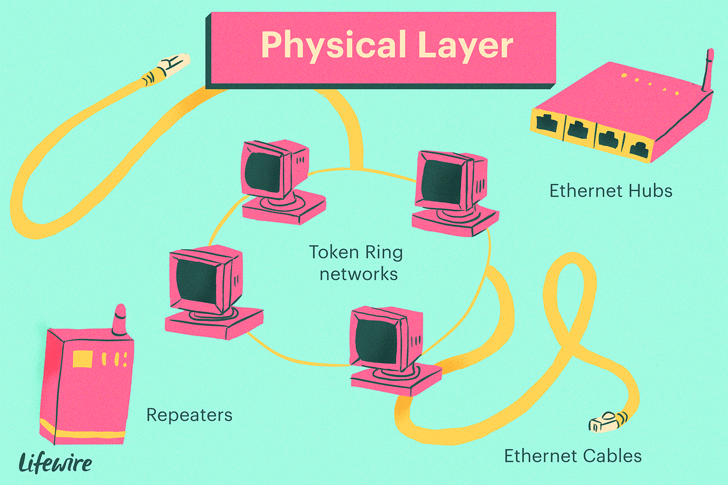
Model OSI Levels
Physical level
The lowest level of the OSI network model is intended directly for data transmission.
Provides an interface between the network media and the network device.

Slide 13
Model OSI OSI stack
An OSI stack is a set of very specific protocol specifications that form a consistent protocol stack.
The OSI stack, unlike other standard stacks, fully complies with the OSI interaction model, it includes specifications for all seven levels of the open systems interaction model.

Slide 14
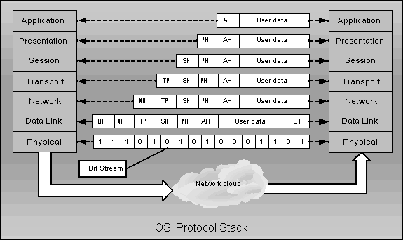
Model OSI OSI stack

Slide 15
Model OSI The disadvantages of the OSI model
Timelessness
Bad technology
Unsuccessful implementation
Bad policy

